Slide 1
C# SESSION - 4
By Muhammad Muneeb Ullah Khan

Slide 2
C# - What is OOP?
OOP stands for Object-Oriented Programming.
Procedural programming is about writing procedures or methods that perform operations on the data, while object-oriented programming is about creating objects that contain both data and methods.
Object-oriented programming has several advantages over procedural programming:
OOP is faster and easier to execute
OOP provides a clear structure for the programs
OOP helps to keep the C# code DRY "Don't Repeat Yourself", and makes the code easier to maintain, modify and debug
OOP makes it possible to create full reusable applications with less code and shorter development time

Slide 3
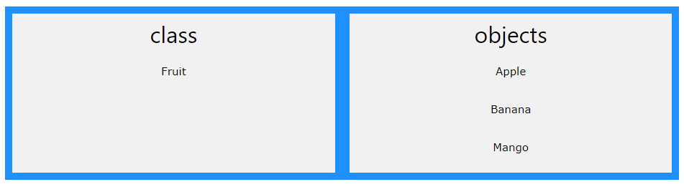
C# - What are Classes and Objects?
Classes and objects are the two main aspects of object-oriented programming.
Look at the following illustration to see the difference between class and objects:

Slide 4
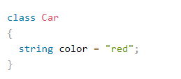
Classes and Objects
Everything in C# is associated with classes and objects, along with its attributes and methods. For example: in real life, a car is an object. The car has attributes, such as weight and color, and methods, such as drive and brake.
Create a Class

Slide 5
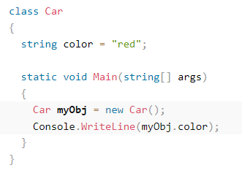
Create an Object
An object is created from a class. We have already created the class named Car , so now we can use this to create objects.
To create an object of Car , specify the class name, followed by the object name, and use the keyword new.

Slide 6
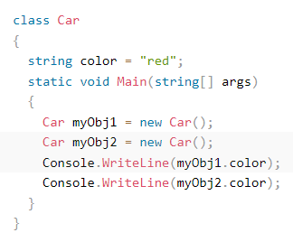
C# Multiple Classes and Objects
Create two objects of Car :

Slide 7
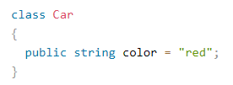
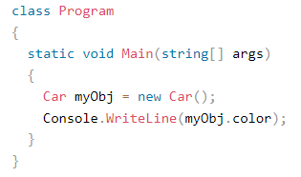
Using Multiple Classes
You can also create an object of a class and access it in another class. This is often used for better organization of classes (one class has all the fields and methods, while the other class holds the Main() method (code to be executed)).
prog2.cs
prog.cs

Slide 8
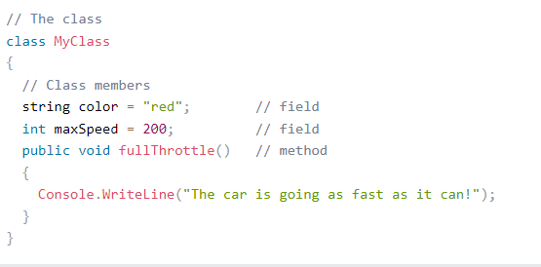
Class Members
Fields and methods inside classes are often referred to as "Class Members":

Slide 9
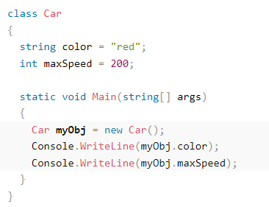
Fields
The following example will create an object of the Car class, with the name myObj . Then we print the value of the fields

Slide 10
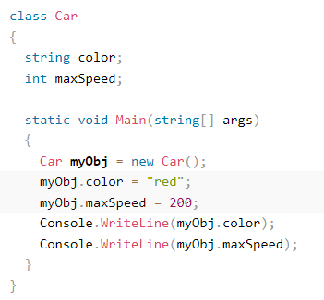
Fields
You can also leave the fields blank, and modify them when creating the object:

Slide 11
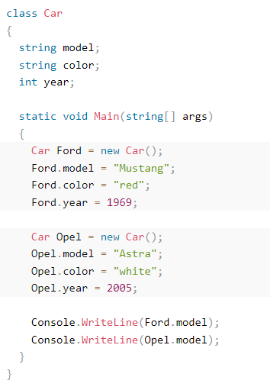
Fields

Slide 12
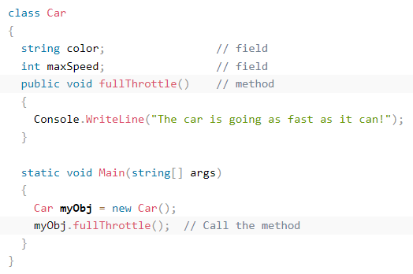
Object Methods
Methods normally belongs to a class, and they define how an object of a class behaves.
Just like with fields, you can access methods with the dot syntax. However, note that the method must be public. And remember that we use the name of the method followed by two parantheses () and a semicolon ; to call (execute) the method:

Slide 13
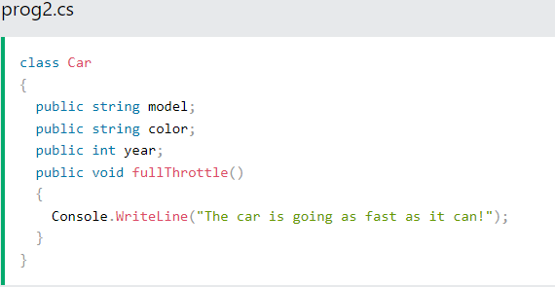
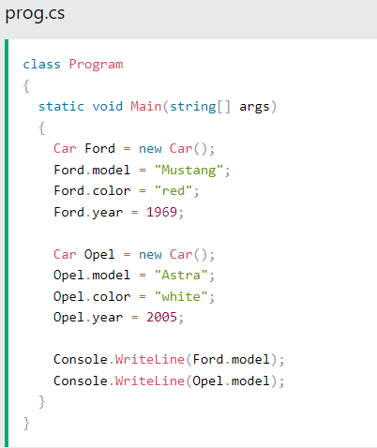
Use Multiple Classes

Slide 14
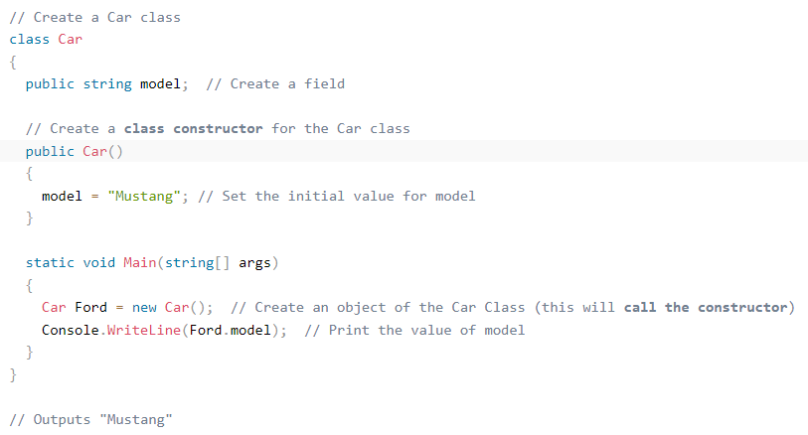
C# Constructors
A constructor is a special method that is used to initialize objects. The advantage of a constructor, is that it is called when an object of a class is created. It can be used to set initial values for fields:

Slide 15
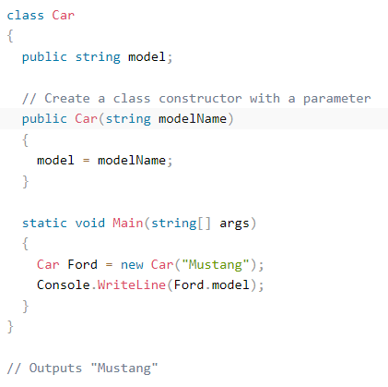
Constructor Parameters
Constructors can also take parameters, which is used to initialize fields.

Slide 16
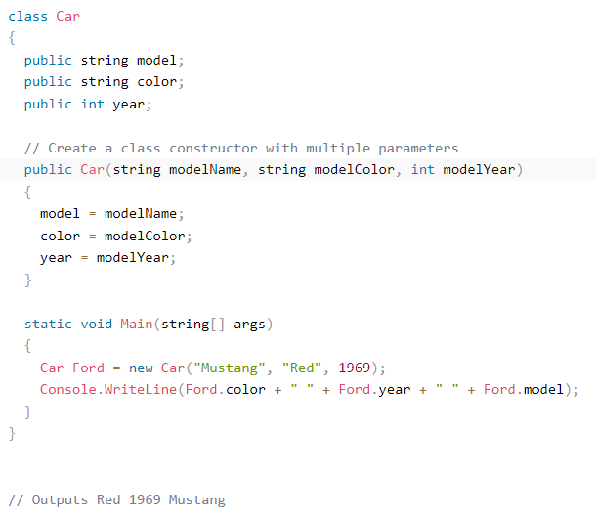
Constructor Parameters
You can have as many parameters as you want:

Slide 17
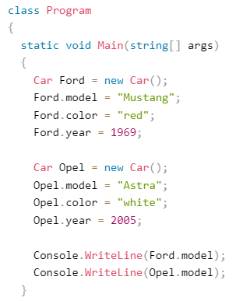
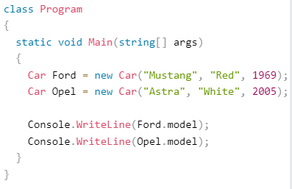
Constructors Save Time
Without constructor: With constructor:

Slide 18
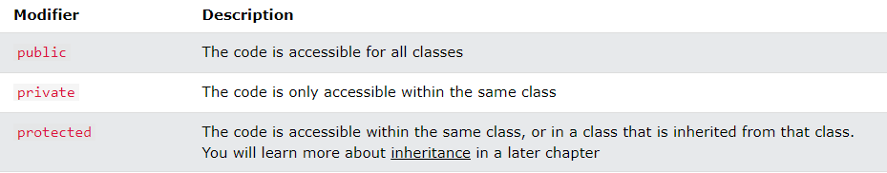
C# Access Modifiers
C# has the following access modifiers:

Slide 19
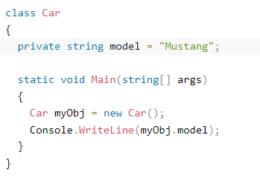
Private Modifier
If you declare a field with a private access modifier, it can only be accessed within the same class:

Slide 20
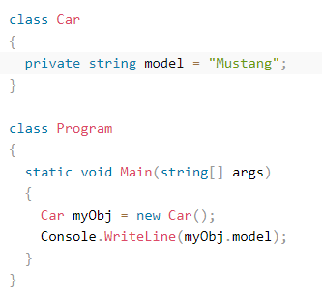
Private Modifier
If you try to access it outside the class, an error will occur:

Slide 21
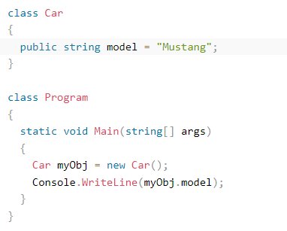
Public Modifier
If you declare a field with a public access modifier, it is accessible for all classes:

